Slide 1

CH 110 : B-tech Laboratory
IIT Guwahati
Experiment 2
Reaction of 4-aminotoluene and o-vanillin (Preparation of Azomethine)

Slide 2
CH 110 : B-tech Laboratory
IIT Guwahati
Solid state reactions
Covalent bond forming bi-molecular organic transformations that proceed rapidly and to a high degree of completion between the solid reactants, actually occur in solid state
A liquid or melt phase formed during the grinding imbues the individual molecules with the required mobility for productive (or reactive) collision, allowing rapid reaction between the two solid reagents.
These are solvent less reactions.
Solid state condensation reactions are waste-free in nature.

Slide 3
CH 110 : B-tech Laboratory
IIT Guwahati
The Reaction
Schiffs Base
Colourless
Yellow
Orange

Slide 4
CH 110 : B-tech Laboratory
IIT Guwahati
Apparatus and Materials
o-Vanillin
4- amino toluene
Watch glass
Spatula
Glass rod
Mortar and pestle (2 sets)

Slide 5
CH 110 : B-tech Laboratory
IIT Guwahati
Procedure
2.8 mmol (0.300g) of 4- aminotoleuene and 2.8 mmol (0.43g) of o-vanillin (m.w.152.15 g/mol) are ground separately using mortar and pestle
Then they are mixed together in a watch glass at room temperature.
When the two powders contact one another, an orange liquid phase forms immediately
After mixing with glass rod the entire mass becomes a homogenous liquid
As the reaction proceeds, solid orange Azomethine product rapidly crystallizes from the liquid phase

Slide 6
CH 110 : B-tech Laboratory
IIT Guwahati
Calculation
Calculate the percentage yield:
Tasks
Find out the melting point of the compound
Take TLC of the compound.
For TLC use following solvent: 5% Ethylacetate in Hexane,
% Yield = (Actual yield/Theoretical yield ) X 100

Slide 7
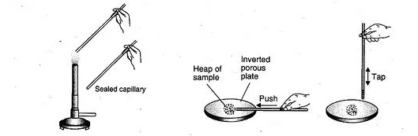
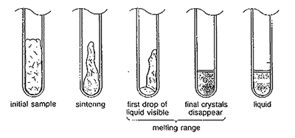
CH 110 : B-tech Laboratory
IIT Guwahati
Melting point determination

Slide 8
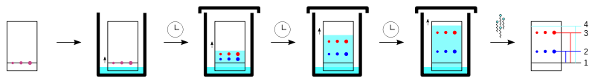
CH 110 : B-tech Laboratory
IIT Guwahati
Thin Layer Chromatography
Chromatographic techniques are analytical methods used for separating compounds from a mixture
Technique used to identify compounds or isolate non-volatile mixtures.
The experiment is conducted on a sheet of aluminium foil, plastic, or glass which is coated with a thin layer of adsorbent material (Stationary Phase).
The adsorbent material usually used is aluminium oxide, cellulose, or silica gel.

Slide 9
CH 110 : B-tech Laboratory
Method
IIT Guwahati
Using a capillary tube, a small spot of solution containing the sample is applied to a plate, about 1.5 centimeters from the bottom edge.
The solvent is allowed to completely evaporate off
Different samples can be placed in a row of spots the same distance from the bottom edge.
A small amount of an appropriate solvent (eluent, Mobile phase) is poured into a glass beaker or any other suitable transparent container (separation chamber) to a depth of less than 1 centimeter.
A strip of filter paper is put into the chamber so that its bottom touches the solvent and the paper lies on the chamber wall and reaches almost to the top of the container. The container is closed with a cover glass or any other lid and is left for a few minutes to let the solvent vapors ascend the filter paper and saturate the air in the chamber.

Slide 10
CH 110 : B-tech Laboratory
IIT Guwahati
Method
The TLC plate is then placed in the chamber so that the spot(s) of the sample do not touch the surface of the eluent in the chamber, and the lid is closed.
The solvent moves up the plate by capillary action, meets the sample mixture and carries it up the plate (elutes the sample).
The plate should be removed from the chamber before the solvent front reaches the top of the stationary phase
Without delay, the solvent front, the furthest extent of solvent up the plate, is marked.
The plate is dried and visualized.
Ultraviolet light
Visualizing chemicals

Slide 11
CH 110 : B-tech Laboratory
IIT Guwahati
Retension factor (R_{f})
Distance traveled by the compound divided by the distance traveled by the solvent.
The larger an R_{f} of a compound, the larger the distance it travels on the TLC plate.
Larger R_{f} factor indicated weaker interaction with the stationary phase, while a smaller R_{f} factor indicated a stronger interaction with the stationary phase.

Slide 12
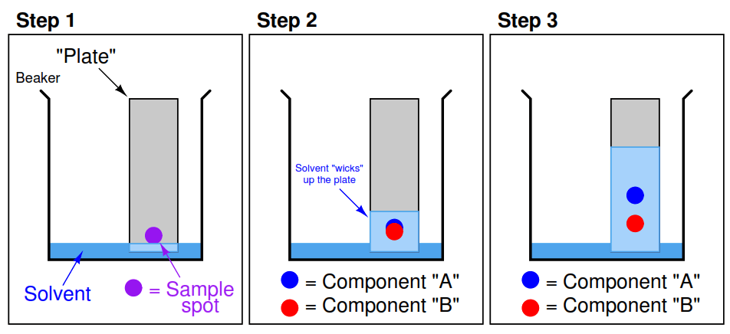
CH 110 : B-tech Laboratory
IIT Guwahati
Application
Isolation of compounds
Different compounds in the mixture have varying properties
Thus they have different extent of interaction with the stationary phase
They are eluted differently
They have different R_{f} values.
Hence the mixture is separated out on the TLC plate
Very useful in monitoring the progress or completion of reactions or to check the purity
of a compound.

